Slide 1
Project- E-Retail customer retention
By-
ASHISH KUMAR SAMAL

Slide 2

BUSINESS PROBLEM FRAMING
Data source about different e-retail websites like Amazon,Flipkart,Snapdeal,Paytm etc.
The data is collected from the Indian online shoppers.
Data Analysis of E-Retail data using given features and its values.
Gives insights about customer need and satisfaction as well as reviews regarding different E-Retail.
Five major factors that contributed to the success of an e-commerce store have been identified as: service quality, system quality, information quality, trust and net benefit.
The research furthermore investigated the factors that influence the online customers repeat purchase intention.
Customer satisfaction has emerged as one of the most important factors that guarantee the success of online store; it has been posited as a key stimulant of purchase, repurchase intentions and customer loyalty.

Slide 3
Background of the Domain Problem
Customer satisfaction is one of the most important factors that guarantee the success of online store. Large number of customers are getting attracted towards the online shopping because e-stores offer them variety of services and products according to their preference.
Some home-grown small e-retailers struggling because of competition. The decision making by these e-tailers becomes very much important in terms of customer activation and retention.
Hence, there is requirement of research on the dynamics of the Indian online retail industry and coming out with the models for successful development of this industry.

Slide 4
…Continued
In this project, we have dataset of customer activation and retention. The primary objective of this study is to propose and analyse the online retail success model with emphasis on proving values to the customers.
This work proposes two online retail success models and analyse them with the data collected from online retail customers in India.

Slide 5
Data Sources and their Formats
More than 47 Columns
269 Rows
No Null Values
Features with customer details
Features with customer reviews
Features with customer needs

Slide 6
Hardware and Software Tools
Laptop
Numpy
Pandas
Imblearn
Seaborn
Matplotlib
Sklearn
Phone
Jupyter
Youtube
Github

Slide 7
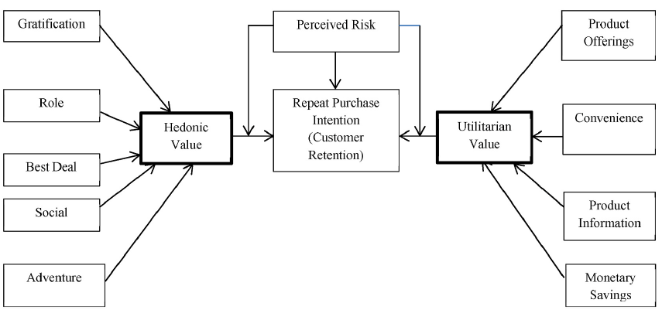
Customers retention model

Slide 8
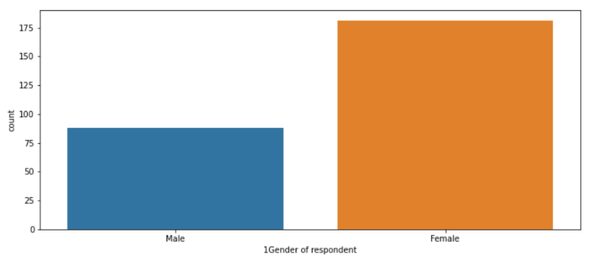
Data Analysis
Gender of the respondent showed that
number of the female is higher than
number of male.

Slide 9
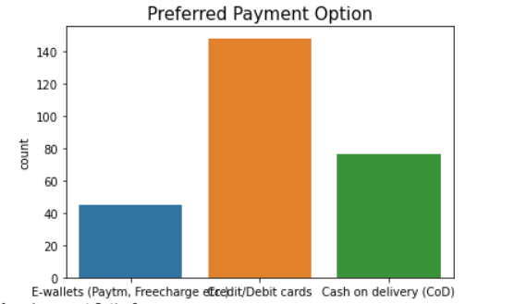
Data Analysis
From the plot we can see that, majority of the respondents pay their bills using debit or credit card, while least number of the respondents pay their bills using e-wallets like Paytm, Freecharge etc.

Slide 10
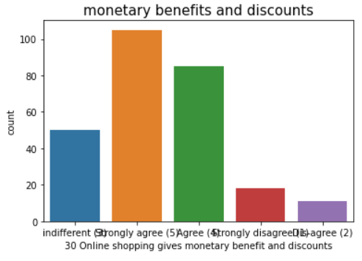
Most of the respondents strongly agree that online shopping websites provide monetary benefit and discounts.
Monetary benefit is utilitarian value and it is one of the major reasons of shopping online is to get value for money, in other words, spend less on products thereby saving more money.
This monetary benefit attracted more customers and increases customers repeat purchase intentions.

Slide 11
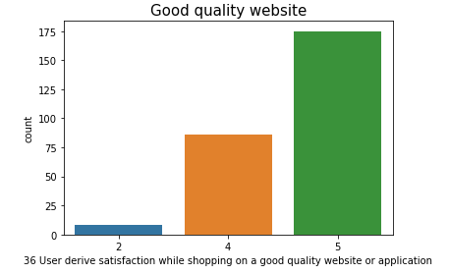
Visualizations
From the plot we can see that, out of 269 respondents 175 respondents strongly agree that quality of website or application is good, while only 8 respondents dis-agree with good quality of website or application. (2=Dis-agree, 4=Agree, 5=Strongly agree)
Good quality website includes performance of the website, page load speed, ease of navigation between pages, appearance, website availability, and website layout.
These values affect the performance of the website and deciding satisfaction of the customers. When customers purchase a product from a website, functionality snags (for example, Website crash, interruption) may result in a poor customer user experience, while good quality websites positively impacts online customer satisfaction.

Slide 12
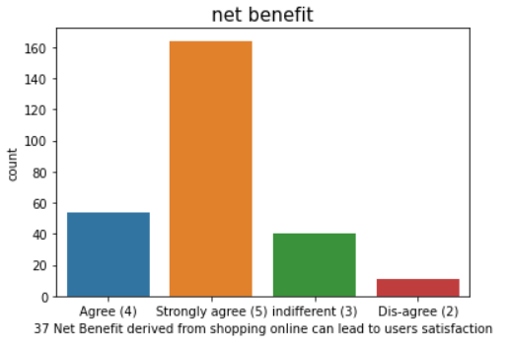
Majority of the customer satisfied with net benefit while shopping online. for instance, money, time, effort, timely delivery, etc.
Net benefit is total benefits received when shopping online by customers, as against the costs (for example, effort, money and time). According to a research net benefit of shopping online includes both utilitarian value and hedonic values.

Slide 13
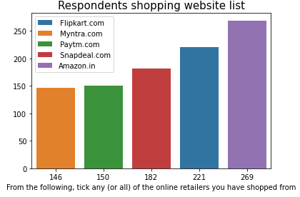
Shopping Websites
From the plot we can see that, all 269 respondents use amazon for online shopping, while out of 269 respondents 146 respondents use myntra for shopping, which is least number
among all categories. (Note: This plot is including those respondents, who use more than one website for shopping.)

Slide 14
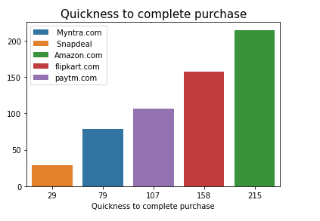
From the plot we can see that, out of 269 respondents 215 say that amazon.com is quick to complete purchase, which is highest among all categories. Flipkart.com is second highest website for quick to complete purchase. (Note: Plot is including those respondents, who gave feedback for more than one website.)

Slide 15
INFEREnces made
@ Amazon.in is used by all the 269 respondents followed by flipkart(221 respondents),snapdeal(182 respondents),
paytm(150 respondents),myntra(146 respondents).
@ Amazon.in is the most voted easy to use web/app,visually appealing web page layout,
and provides wild variety of product on offer with complete and relevant information and description of products.
@ Amazon.in has a fast loading website with most reliability and quick to complete a purchase.
@ Almost all e retail have a wide range of payment options.
@ Amazon is most voted for speedy order delivery and myntra and flipkart has least votes.
@ Privacy and security of customer data is most safe with amazon.in as per the responses followed by flipkart.
@ Amazon provides online assistance through multi-channel,whereas paytm has least assistance.

Slide 16
@ During promotion and sales period,amazon users face long time to log in and displaying graphics/photo followed by
paytm and snapdeal.
@ During promotion and sales period myntra declares price the most late,followed by paytm.
@ Paytm takes longer time to load page,followed by snapdeal and amazon.
@ During promotion snapdeal has most limited mode of payment followed by amazon.
@ Paytm has long delivery time.
@ Amazon has developed their website/application design over time and still efficient.
@ Amazon has got best customer loyalty as it has the most percieved trustworthiness but
it needs to upgrade the platforms to take less time to load or log in during promotion or sales period.
@ Myntra,snapdeal and paytm should develop their performance of platform and percieve more trustworthiness by
securing the privacy of customer data.

Slide 17
Customer needs
we can see customers want the following services---
@ users want a wide variety of listed product in several category.
@ userfriendly interface in which contents are easy to read and
understood,want product comparison alomg with complete andrelevant info on listed products to be stated clearly.
@ Ease of navigation in website,along with the loading and processing speed.
@ Convinient payment methods.
@ Empathy towards customer and guarantee the privacy of the customer leads to more trust worthiness which leads to
user satisfaction.
@ The need of assistance along with responsivness on several channels like web,email,phone,etc.
@ several customers feel the sense of adventure,gratification on shopping from their favorite e-tailer and
enhances the social status too.

Slide 18
Conclusion
To run an effective web-based retail store, accentuation should be given to the factors important for client fulfilment. For example, items data, framework and administration characteristics, net advantages, and so forth By and by, e-rears are needed to incorporate different advantages also to make worth to the client. From the examination we can say that the nature of framework, data, openness, security, and convenience are expected to speak to the buyer's utilitarian qualities. On the other hand, to speak to the gluttonous upsides of the customer, the e-store should consolidate components that would offer worth to the joy looking for conduct of clients; for instance: experience, satisfaction, job shopping and so forth.

Slide 19
THANKYOU
Github Link-https://github.com/Ashsam2310/Practice_Projects/

